Slide 1
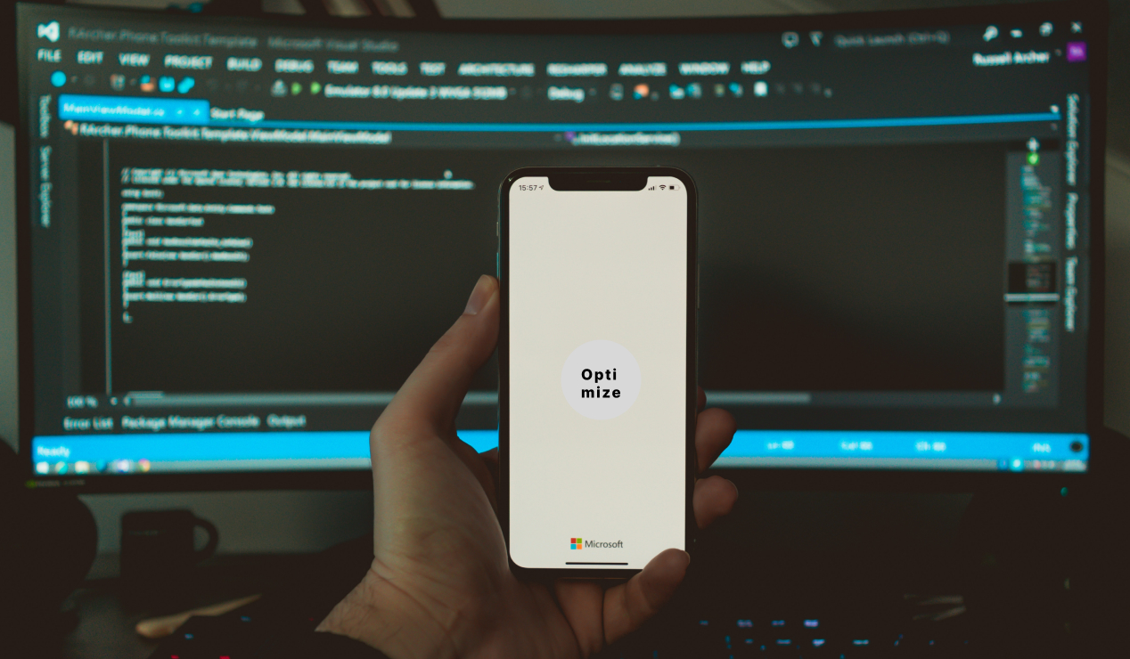

Slide 2
Project overview
The product:
This website Target user’s like photographer to get to know more skills and learn &also for the brands that want services for there products
Project duration:
Insert the time that you worked on this design project - e.g., Month Year to Month Year

Slide 3
Project overview
The problem:
Limited Exposure: It can be difficult for photographers to get sufficient exposure and reach their target audience. Competition is high, and standing out among other photographers can be challenging.
Finding Clients: Building a client base and finding consistent work can be a significant hurdle. Attracting potential clients and convincing them to hire a particular photographer requires effective marketing and networking.
The goal:
Create attractive packages, discounts, or limited-time offers to incentivize potential clients to book the photographer's services. Promote these promotions through various channels, including social media, email marketing, and the photographer's website.

Slide 4
Project overview
My role:
Identify your role in the project - e.g., lead UX designer, UX researcher, etc.
Responsibilities:
List the responsibilities you had throughout the project - e.g., user research, wireframing, prototyping, etc.

Slide 5
Understanding
the user
User research
Personas
Problem statements
User journey maps

Slide 6
User research: summary
The research involved a comprehensive analysis of various strategies and best practices employed by successful photographers. Multiple sources, including industry publications, case studies, and expert opinions, were consulted to gather relevant information and insights. The focus was on identifying common challenges faced by photographers and examining effective approaches to overcome them

Slide 7
User research: pain points
1
2
3
4
Pain point
Pain point
Pain point
Pain point
Photographers facing ‘
Networking & Collaborations
Wont abel to share there Portfolio
Facing client Relationship and Management
Every user have to build there own websites for sharing there portfolio

Slide 8
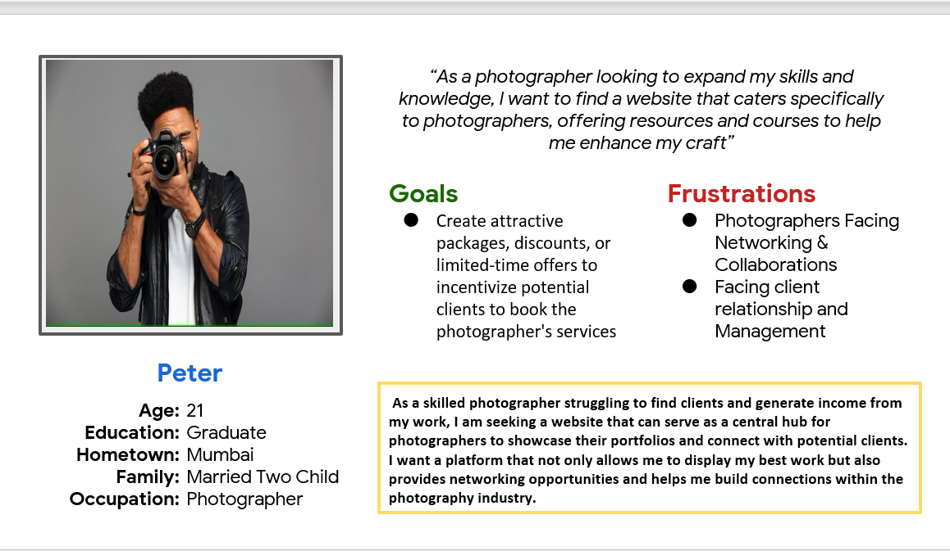
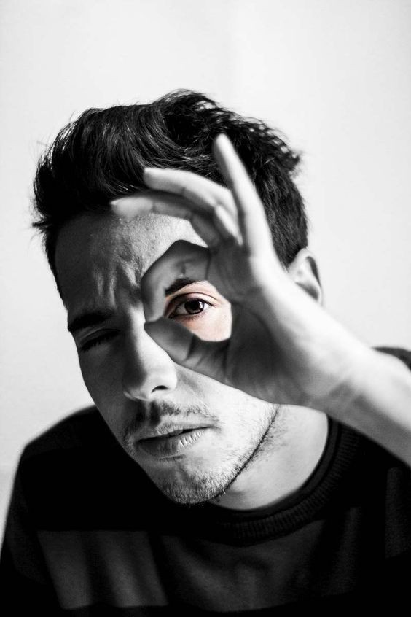
Persona:peter
Problem statement:
Peter is a photographer
who needs find clients
because he wants to earn some money for buying new kits.

Slide 9
Paper wireframes
Digital wireframes
Low-fidelity prototype
Usability studies
Understanding
the user

Slide 10
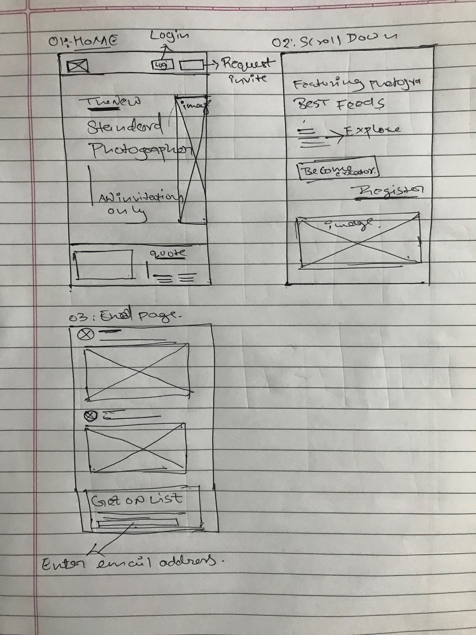
Paper wireframes
[MAKE NEW STANDARDS FOR PHOTOGRAPHERS &
BRANDS ]

Slide 11
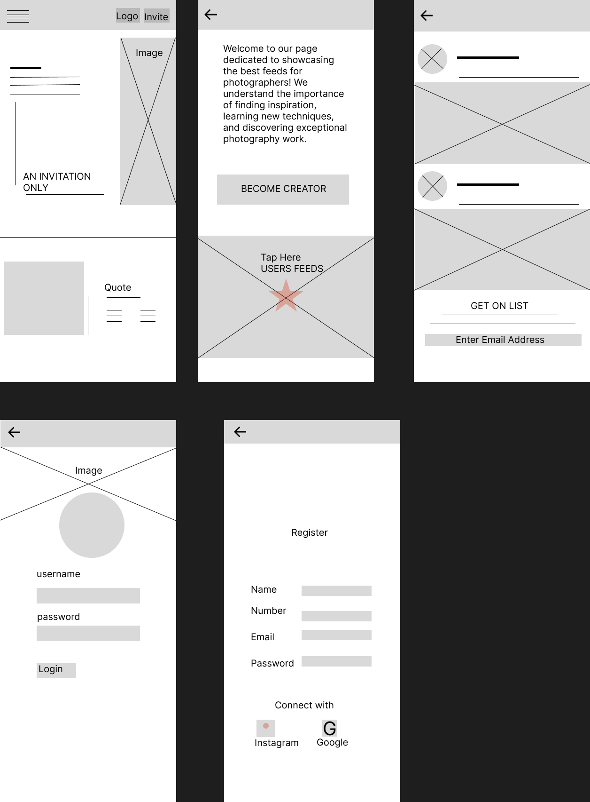
Digital wireframes
Description of the element and its benefit to the user
[Your notes about goals and thought process]
Insert first wireframe example that demonstrates design thinking aligned with user research
Description of the element and its benefit to the user

Slide 12
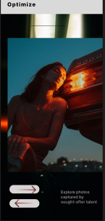
Digital wireframes
Visiting our website to find motivation through pictures can be an incredibly uplifting experience
our platform provides an exceptional opportunity for users to attract clients effortlessly, as they can showcase their skills and offerings to a diverse audience at no cost.
As you navigate through the vibrant collection of images, each one has the power to ignite your determination and inspire positive change

Slide 13
Low-fidelity prototype
[Link to low-fidelity prototype and brief description of the user flow]
Screenshot of prototype with connections or prototype GIF

Slide 14
Usability study: findings
Write a short introduction to the usability studies you conducted and your findings.
Round 1 findings
Round 2 findings
1
Identification of usability issues related to finding clients and the sign-in page.
1
issues related to navigating back from pages
2
the challenges faced by users when attempting to contact other users
Insights into the user experience and challenges faced during the photo upload and client interaction process
2
3
Recommendations for improving the app's navigation, back button functionality, and contact features to enhance user satisfaction and ease of communication
3
Recommendations for improving the app's usability, interface, and user flow to enhance user satisfaction and streamline client acquisition.

Slide 15
Mockups
High-fidelity prototype
Accessibility
Refining
the design

Slide 16
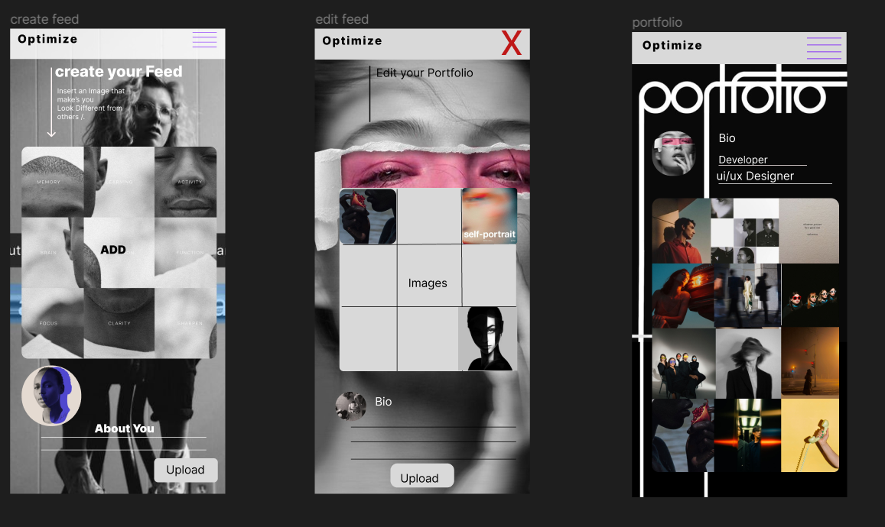
Mockups
Before usability study
After usability study
[Creating a design for a platform that connects photographers with potential clients and allows them to showcase their portfolios and learn from others is a fantastic idea]

Slide 17
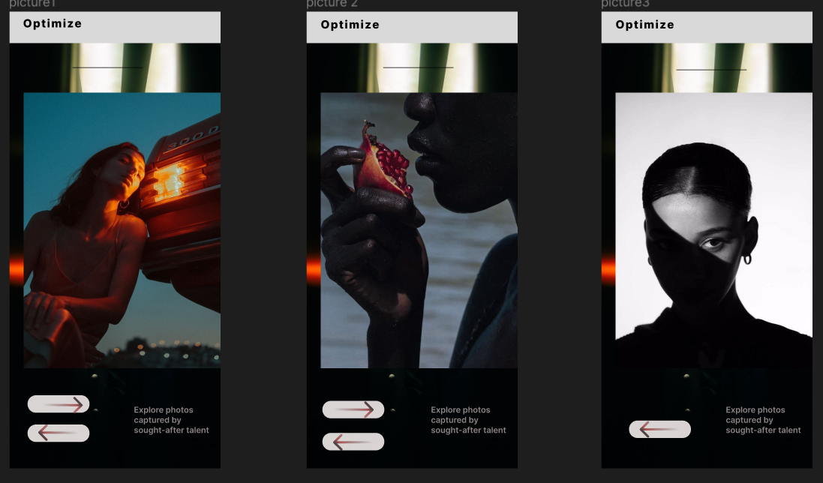
Mockups
Main mockup screen for display
Main mockup screen for display
Main mockup screen for display

Slide 18
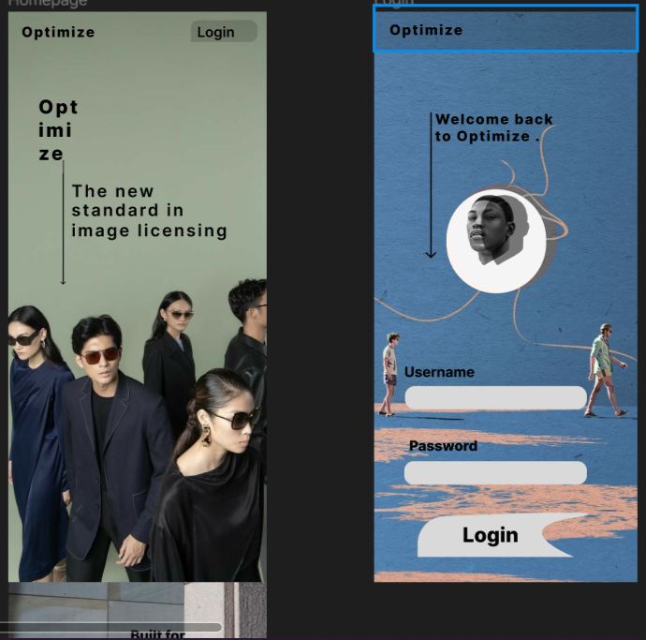
High-fidelity prototype
[https://www.figma.com/file/Ex294RrCyMl62gR5l82JFe/photo?type=design&node-id=271%3A11&mode=design&t=cucpCxa4TGjBSBWA-1]
Screenshot of prototype with connections or prototype GIF

Slide 19
Going forward
Takeaways
Next steps

Slide 20
Takeaways
Impact: Empowering Photographers: Your platform provides photographers with a professional online presence, helping them showcase their skills and portfolios to a broader audience. This can lead to increased exposure and potential client opportunities.
Connecting Clients and Photographers: Clients can easily find photographers that match their preferences and needs, simplifying the process of hiring a photographer for various occasions.
What I learned:
Web Development and Design: Developing the platform involves gaining proficiency in HTML, CSS, and potentially JavaScript. You'll also learn about responsive design and user interface principles.
Prototyping and UI/UX Design: Creating mockups and prototypes teaches you about user-centered design, information architecture, and the importance of intuitive interfaces.
.

Slide 21
Next steps
1
2
3
Prototype and Test: Create an initial prototype of your platform and start testing it. Gather feedback from potential users to identify areas for improvement..
Based on user feedback, refine the design and functionality of your platform to enhance user experience.
Implement Learning Hub (If Applicable): Develop the blog section or learning hub where photographers can access valuable resources and tips.

Slide 22
THANK YOU
Mirjam Nilsson​
206-555-0146
mirjam@contoso.com
www.contoso.com

